Slide 1
Structure Programming
ICT-1105
Information and Communication Technology
Lecture-12
Date:

Slide 2
Class contents has given in Google Classroom with code
nhauiw4

Slide 3
Jump Statements

Slide 4
Jump Statements
Jumping statements are used to transfer the program’s control from one location to another, these are set of keywords which are responsible to transfer program’s control within the same block or from one function to another.

Slide 5
Jump Statements
There are four jumping statements in C language:
break statement
continue statement
goto statement
return statement

Slide 6
Break Statement
Break is a keyword. The break statement provides an early exit from for, while, and do, just as from switch. A break causes the innermost enclosing loop or switch to be exited immediately. When break is encountered inside any loop, control automatically passes to the first statement after the loop.

Slide 7
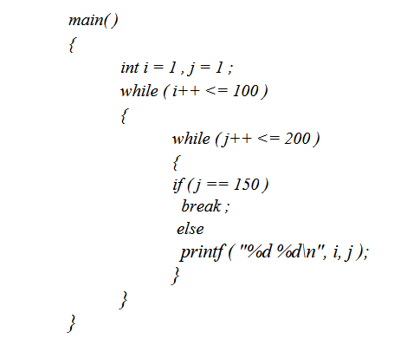
Break Statement
Consider the following example;

Slide 8
Break Statement
In this program when j equals 150, break takes the control outside the inner while only, since it is placed inside the inner while.

Slide 9
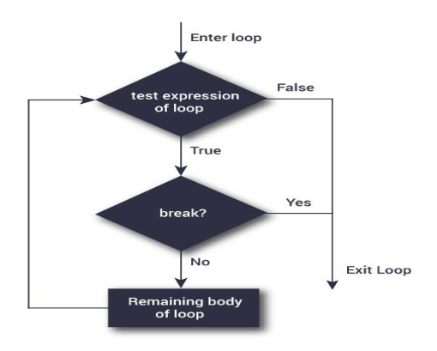
Syntax & Flowchart of break statement
break;
Flowchart:

Slide 10
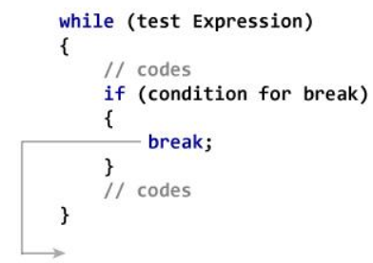
How break statement works?

Slide 11
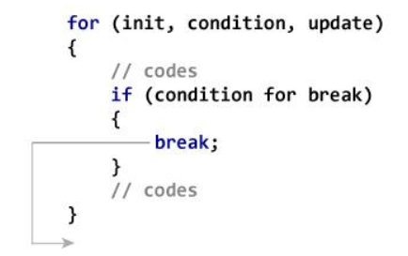
How break statement works?

Slide 12
How break statement works?
#include <stdio.h>
#include <conio.h>
void main()
{
int i=1;//initializing a local variable
clrscr();
//starting a loop from 1 to 10
for(i=1;i<=10;i++)
{
printf("%d \n",i);
if(i==5)
{
//if value of i is equal to 5, it will break the loop
break;
}
} //end of for loop
getch();
}
Notes:
Output
12345

Slide 13
continue Statement
Continue is keyword exactly opposite to break. The continue statement is used for continuing next iteration of loop statements. it causes the next iteration of the enclosing for, while, or do loop to begin. When it occurs in the loop it does not terminate, but it skips some statements inside the loop / the statements after this statement.

Slide 14
continue Statement
In the while and do, this means that the test part is executed immediately; in the for, control passes to the increment step. The continue statement applies only to loops, not to switch.

Slide 15
continue Statement
Consider the following program:
main( )
{
int i, j ;
for ( i = 1 ; i <= 2 ; i++ )
{
for ( j = 1 ; j <= 2 ; j++ )
{
if ( i == j)
continue ;
printf ( "\n%d %d\n", i, j ) ;
}
}
}
Notes:
The output of the above program would be...
1 2
2 1

Slide 16
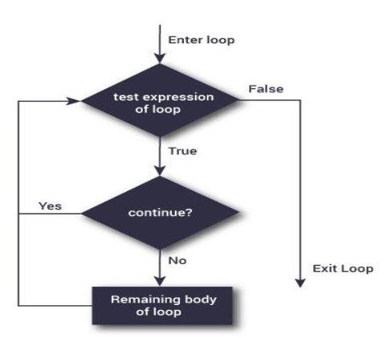
Syntax & Flowchart of continue Statement
Syntax of continue Statement
continue;
Flowchart:

Slide 17
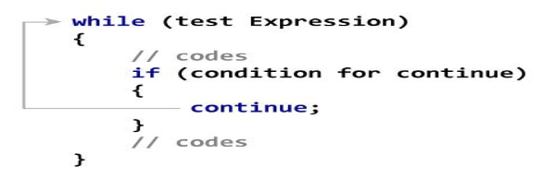
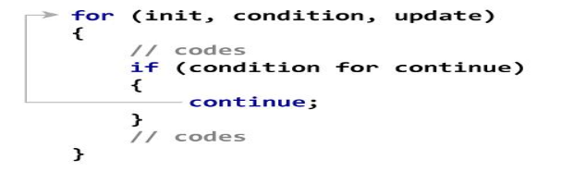
How continue statement works?

Slide 18
How continue statement works?
#include <stdio.h>
#include <conio.h>
void main()
{
int i=1;//initializing a local variable
clrscr();
//starting a loop from 1 to 10
for(i=1;i<=10;i++)
{
if(i==5)
{ //if value of i is equal to 5, it will continue the loop
continue;
}
printf("%d \n",i);
}//end of for loop
getch();
}
Notes:
1234678910

Slide 19
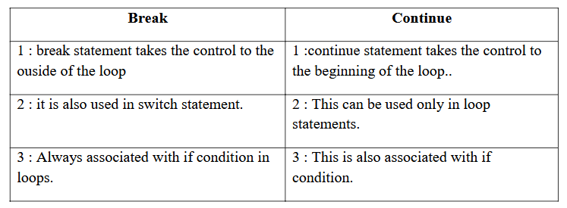
Comparision between break and continue statements

Slide 20
goto Statement
The goto statement causes your program to jump to a different location, rather than execute the next statement in sequence.
The format of the goto statement is;
goto statement label;

Slide 21
goto Statement
Consider the following program fragment
if (size > 12)
goto a;
goto b;
a: cost = cost * 1.05;
flag = 2;
b: bill = cost * flag;
Notes:
Here, if the if conditions satisfies the program jumps to block labelled as a: if not then it jumps to block labelled as b:

Slide 22
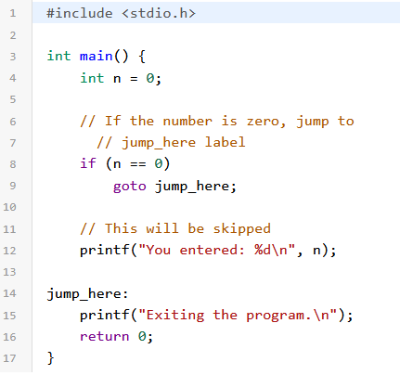
goto Statement

Slide 23
goto Statement
Consider the following program fragment
if (size > 12)
goto a;
goto b;
a: cost = cost * 1.05;
flag = 2;
b: bill = cost * flag;
Notes:
Here, if the if conditions satisfies the program jumps to block labelled as a: if not then it jumps to block labelled as b:

Slide 24
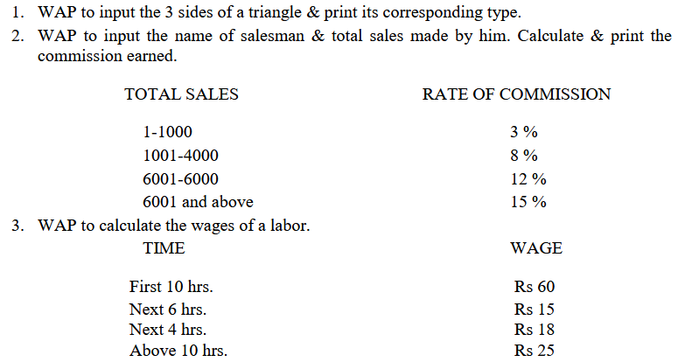
Assignment

Slide 25
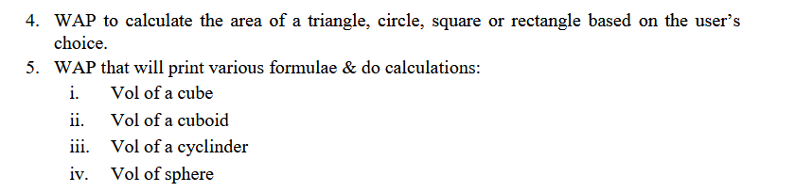
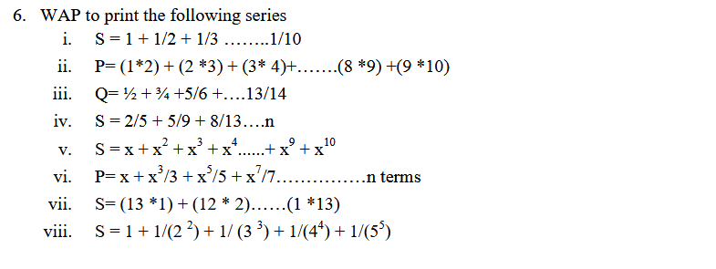
Assignment

Slide 26
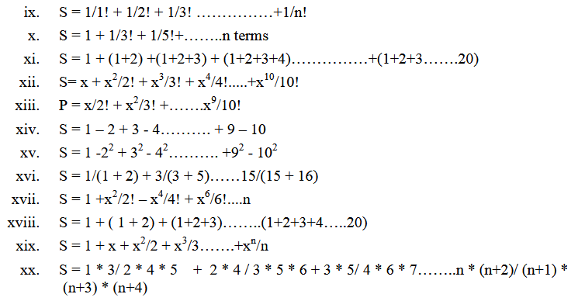
Assignment

Slide 27
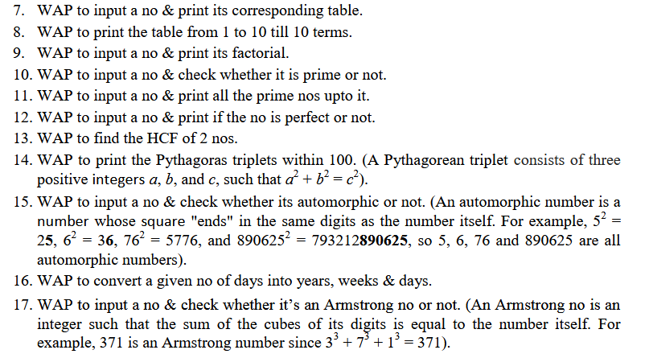
Assignment

Slide 28
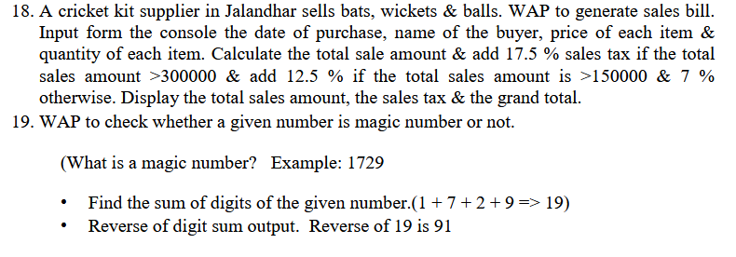
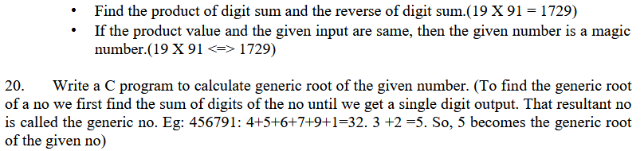
Assignment

Slide 29
Thank you….

